Slide 1
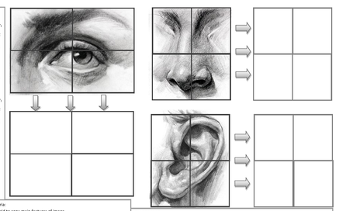
FACIAL FEATURES: Draw outline accurately before adding shading

